Slide 1
Line-In Noise
2016-10-20
WEA

Slide 2
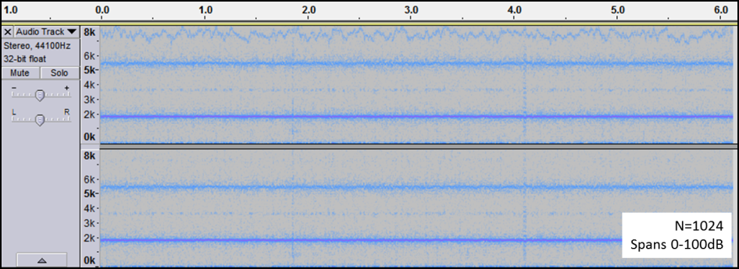
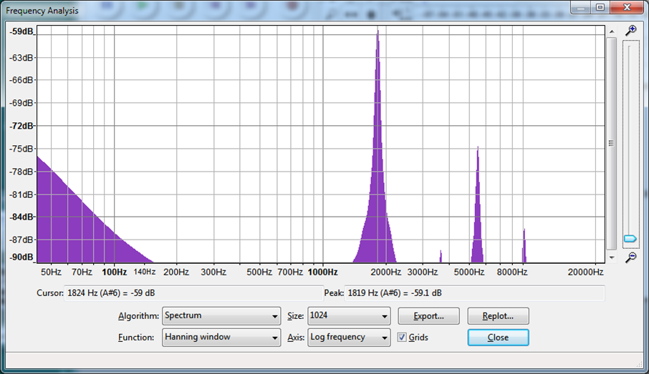
Test Notes
I posted the first part of this test to the Teensy Forum: https://forum.pjrc.com/threads/38370-Reducing-Noise-Analog-Supply?p=119481&viewfull=1#post119481
I did a test using LineIn as my input (using the default LineIn gain command of 5) and I set the headphone volume to be 0.5. Attached to my LineIn are are two electret mics from Adafruit (SPW 2430), though it makes the same noise if I replace the microphones with 1 kHz resistors.
I recorded the audio over USB into Audacity via the Teensy's USB Audio Output feature, as I found that the noise sounds similarly through the headphones or via USB into the computer.
During this recording, my laptop was unplugged from the wall outlet, but that makes no difference. Also, I've run the Teensy off battery (to my headphones) and it makes this same noise.
Right is the spectrogram. It shows strong lines at ~2 kHz and ~5.5 kHz. They're strong but fuzzy, which reflects that they don't sound stationary. There's also some lower frequency garbage that is apparent when you make it louder, though this low-frequency stuff is not nearly as annoying as the high-frequency stuff.
Right is the average spectrum for the whole recording. I don't like how Audacity auto-ranges the vertical axis, but you can clearly see that the ~2kHz tone (actually 1.8 kHz) is about 59 dB down from "full scale", which is quite noticeable. If you want to apply any additional gain (for super-hearing!) this tone gets louder and quickly becomes unbearably annoying.

Slide 3
Tests Performed
Self Noise Both Channels, Microphones to Line In. Line In = 5. Headphone = 0.5
Sine Wave at 0.5 in one channel. Mic self noise in other channel. Line In = 5. Headphone = 0.5
Same as (2) but Headphone at 0.75
Same as (2) but Headphone at 0.9
Repeat (4)
Return to (1) but Line-In = 15
Same as (6) but Line-In = 10
Return to (1), but replace mics with shorts.
Same as (8) but Line-In = 15
Same as (8) but Line-In = 10

Slide 4
Effect of Line-In Setting
As the broadband (top) and A-weighted plots (bottom) show different trends, I think that the Line-In noise is not affected by the line-in setting. Wow.

Slide 5
Effect of Headphone Volume
Because the volume of the tone doesn’t change, clearly the USB Audio is not affected by the headphone volume. Any effect on line-in noise needs more tests.

Slide 6
Effect of Shorting the Input
Repeat
The mics and the shorted inputs give the same noise. So, the line-in noise is louder than the ambient sound picked up by the mics (in my kitchen). Also, the line-in noise is present even when shorted…wow!

